Slide 1



Slide 2
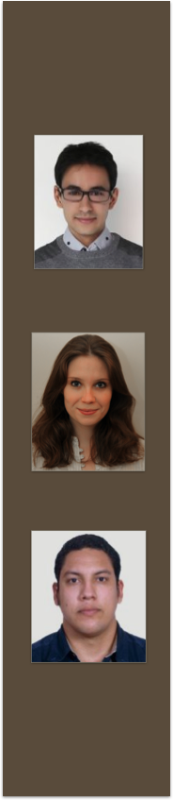
Massine AKILAL - France –
Mechanics and Energy
Morgane BARILLET - France –
Quality & Supply Chain
Santiago COELLO – Equador –
Mecanical Engineering

Slide 3


Slide 4
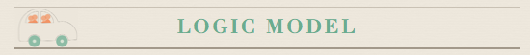
OUTPUTS
INPUTS
Activities: IAR
Participants
OUTCOMES
Market analysis
Companies and strategies around the world
Challenges
The challenges that ridesharing companies, users and government are and will have to solve)
Technology analysis
(the technological tools being used and that can be improved)
Transportation analysis
Law and Public policy
Social awareness
Efficient transportation
Traffic flow and reduction of CO2 emissions. Reduce transportation cost.
Market – Economic
Develop the market of carpooling and help new companies to take better decisions and strategies.
Social Impact
Understand the behavior and practice of people carpooling
Policies
Development of policies in order to regulate and increase the users of carpooling.
Improve security in carpooling
Resources:
Articles
Journals
Books
Lectures
Videos
Time:
One semester
Assistance:
Professors
The team members
Professors
Teacher assistant
Classmates
ASSUMPTIONS
External analysis report
Most part of statistics about carpooling are based in USA info.
EXTERNAL FACTORS
Government laws
Public transportation
Price of energy
Security

Slide 5
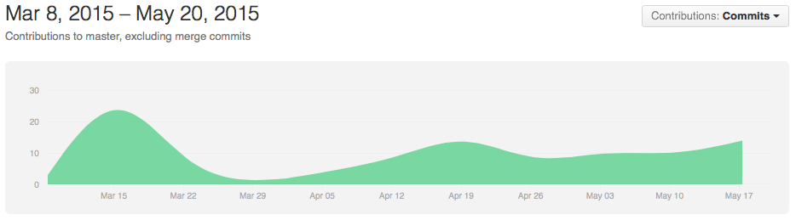
GitHub Progression

Slide 6
Thanks for your attention !

